Slide 1
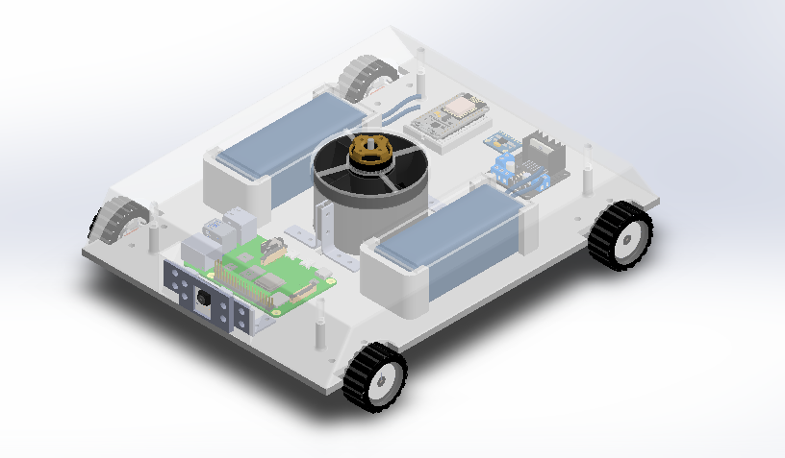
Mechanical Design

Slide 2
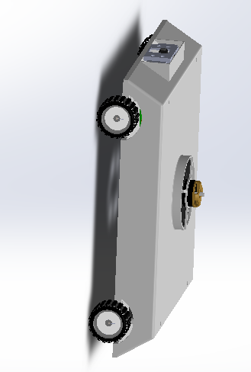
Mechanical Design
Modular Design
CG Balanced
Compact and Durable Structure
Nylon Nuts for Damping
Aerodynamic Symmetric Structure

